Slide 1

Artificial Intelligence
Structures and Strategies for Complex Problem Solving
— Chapter 11 —

Slide 2
Chapter 11. Machine Learning: Connectionist
11.0 Introduction
11.1 Foundations for Connectionist Networks
11.2 Perceptron Learning
11.3 Backpropagation Learning.
11.4 Convolutional Nerual Network
11.5 Generative Adversarial Networks

Slide 3
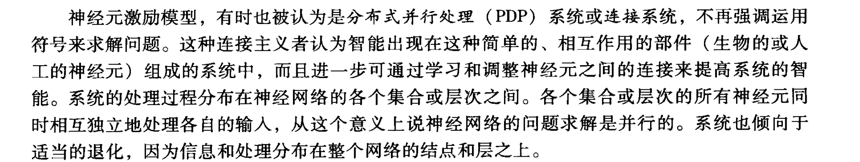
11.0 Introduction
We introduce neurally or biology inspired approaches to learning
Neurally inspired models, sometimes known as parallel distributed processing (PDP) or connectionist systems, de-emphasize the explicit use of symbols in problem solving.
They hold that intelligence arise in systems of simple, interacting components through a process of learning or adaptation by which the connections between components are adjusted.
神经元激励模型
分布式并行处理系统或者连接系统

Slide 4
11.0 Introduction
Process in these is distributed across collections or layers of neurons。
Problem solving is parallel in the sense that all the neurons within the connection or layers process their inputs simultaneously and independently. These systems also tend to degrade gracefully because information and processing are distributed across the network’s nodes and layers.

Slide 5
11.0 Introduction
The neural/connectionist approach is well suited include:
Classification, deciding the category or grouping to which an input value belongs
Pattern recognition, identifying structure or pattern in data
Memory recall, including the problem of content addressable memory
Prediction, such as identifying disease from symptoms, causes from effects

Slide 6
11.0 Introduction
Optimization, finding the “best” organization of constrains
Noise filtering, or separating signal from background, factoring out the irrelevant components of a signal

Slide 7
11.1 Foundations for Connectionist Networks
Early history
The basis of neural network is the artificial neural
An artificial neural consists of:
Input signals
A set of real valued weights
An activation level
A threshold function f

Slide 8
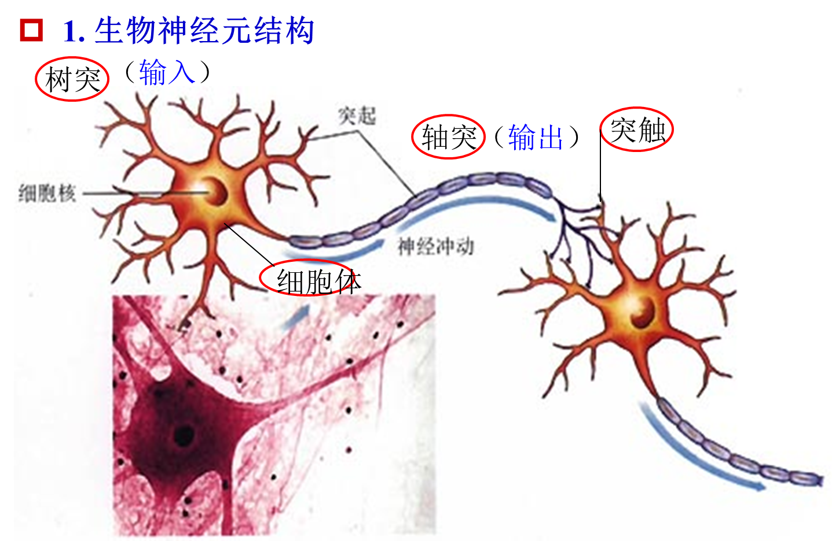
11.1 Foundations for Connectionist Networks

Slide 9
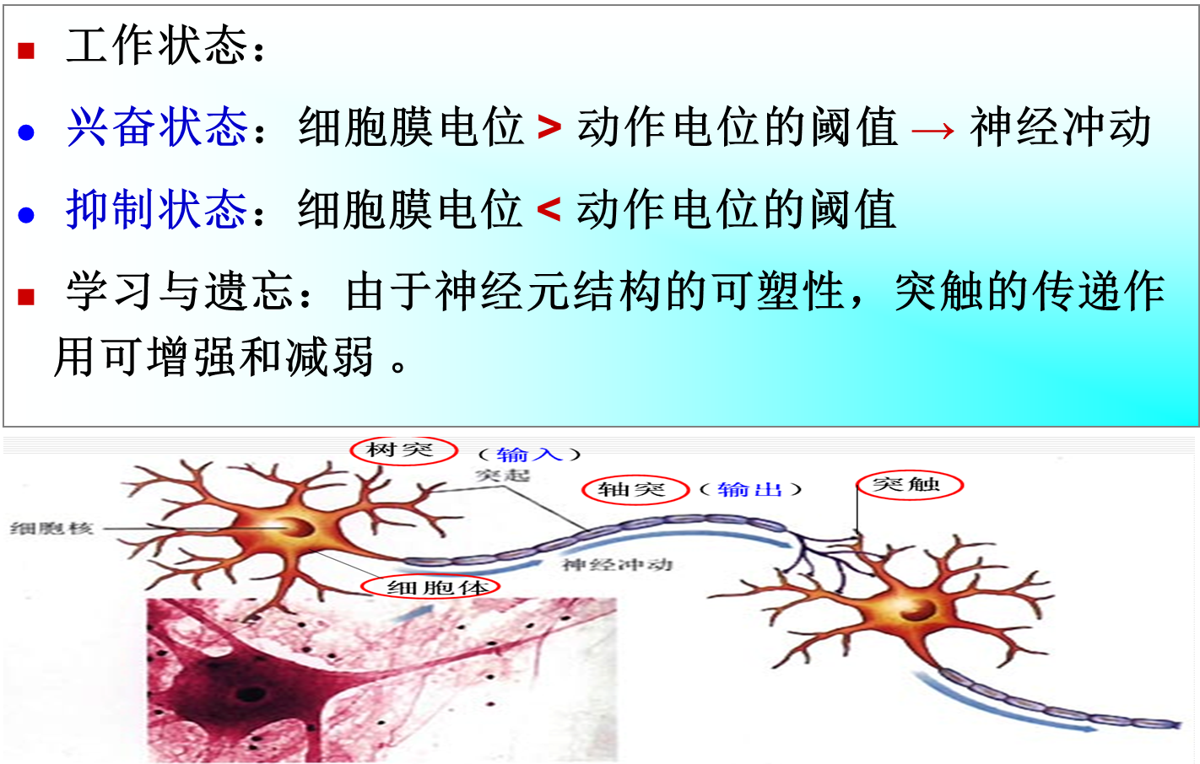
11.1 Foundations for Connectionist Networks

Slide 10
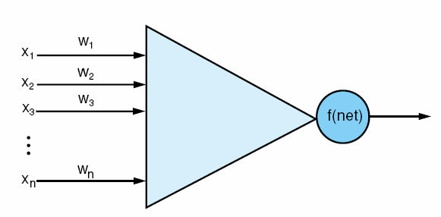
11.1 Foundations for Connectionist Networks
Fig 11.1 An artificial neuron, input vector x_{i}, weights on each input line, and a thresholding function f that determines the neuron’s output value. Compare with the actual neuron in fig 1.2

Slide 11
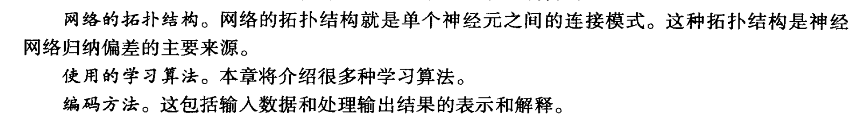
11.1 Foundations for Connectionist Networks
A neural network is also characterized by global properties such as:
The network topology
The learning algorithm
The encoding scheme

Slide 12
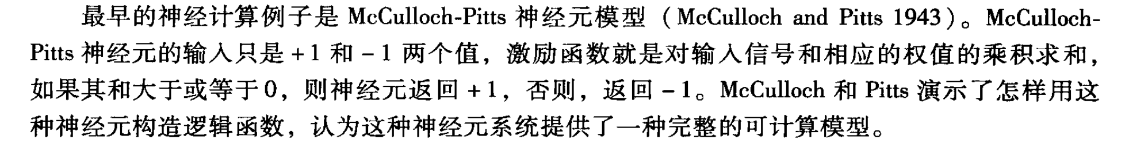
11.1 Foundations for Connectionist Networks
The McCulloch-Pitts neuron
It’s the earliest example of neural computing
The input to a McCulloch-Pitts neuron are either excitatory (+1) or inhibitory (-1).
The activation function multiplies each input by its corresponding weight and sums the results
If the sum is greater than or equal to 0, the neuron returns 1, otherwise -1
McCulloch and Pitts showed how these neurons could be constructed to compute any logical function, demonstrating that systems of these neurons provide a complete computational model

Slide 13
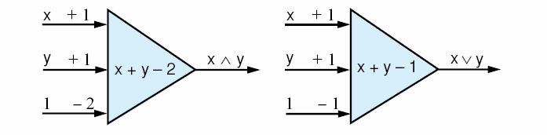
11.1 Foundations for Connectionist Networks
Fig 11.2 McCulloch-Pitts neurons to calculate the logic functions and and or.

Slide 14
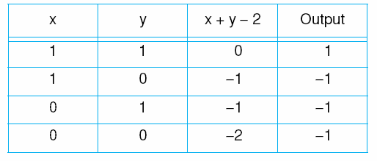
11.1 Foundations for Connectionist Networks
Table 11.1 The McCulloch-Pitts model for logical and.

Slide 15
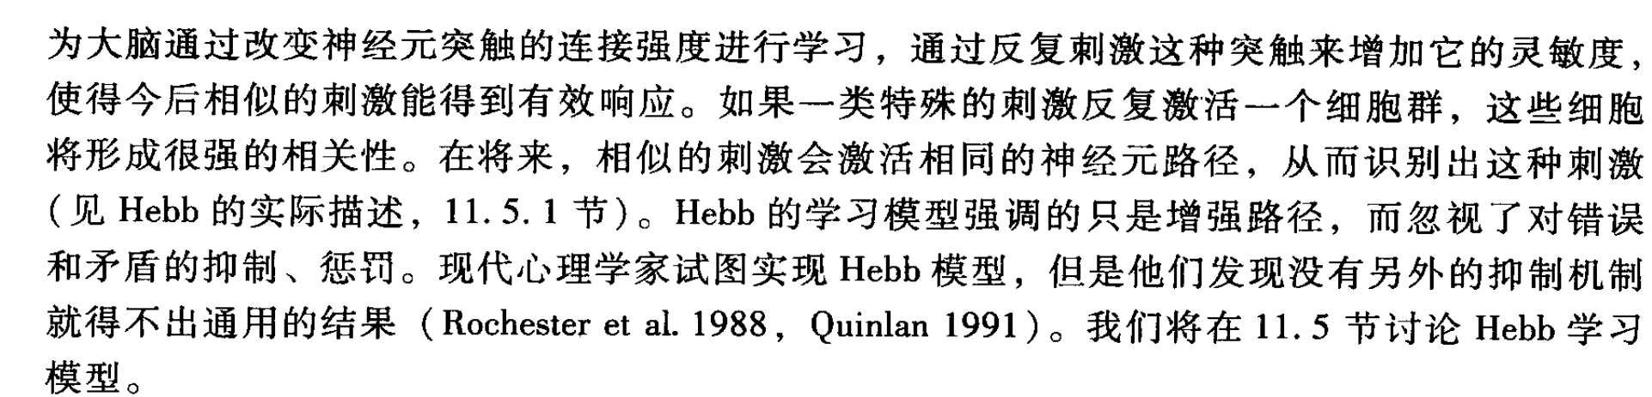
11.1 Foundations for Connectionist Networks
The psychologist D.O.Hebb theorized that repeated firings across a synapse increased its sensitivity and the future likelihood of its firing
If a particular stimulus repeatedly caused activity in a group of cells, those cells come to be strongly associated. In the future, similar stimuli would tend to excite the same neural pathways, resulting in the recognition of the stimuli.

Slide 16
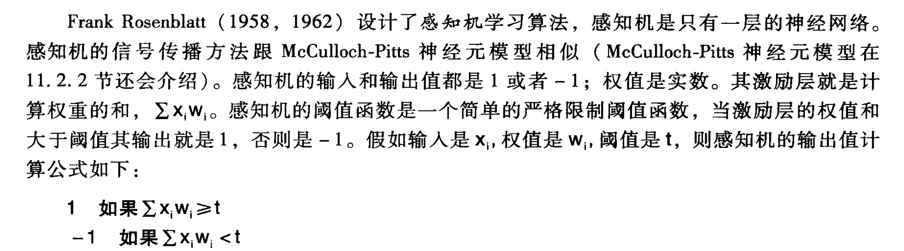
11.2 Perceptron Learning
Frank Rosenblatt devised a learning algorithm for a type of single layer network called a perceptron
The input values and activation levels of the perceptron the either -1 or 1
Weights are real valued
The activation level of the perceptron is given by summing the weighted input values,

Slide 17
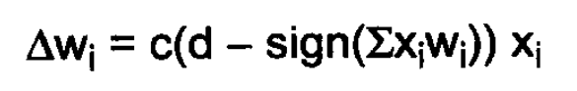
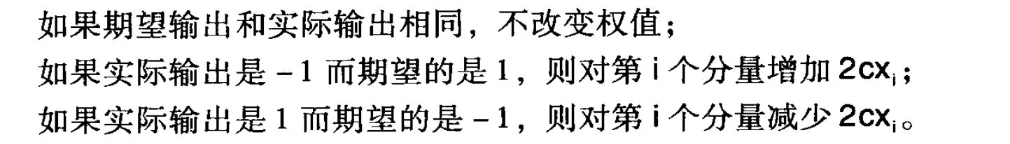
11.2.1The Perceptron Training Algorithm
Perceptrons use a simple hard-limiting threshold function, where an activation above a threshold results in an output value of 1, and -1 otherwise.
Given input values ,weights ,and a threshold t, the perceptron computes its output values as:
1 if
-1 if

Slide 18
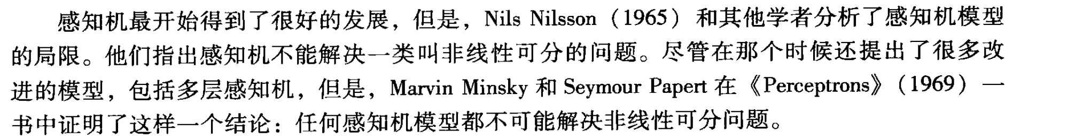
11.2.1The Perceptron Training Algorithm
The perceptron uses a simple form of supervised learning
However, Nile Nilsson and others analyzed the limitations of the perceptron model.
They demonstrated that perceptrons could not solve a certain diffcult class of problems, namely problems in which the data points are not linearly separable

Slide 19
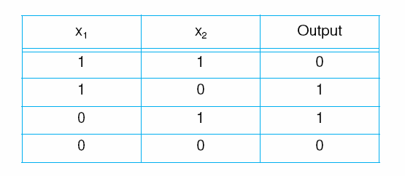
11.2.1The Perceptron Training Algorithm
An example of a nonlinerably separable classification is exclusive-or.
Table 11.2 The truth table for exclusive-or.

Slide 20
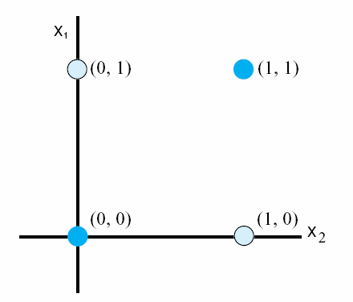
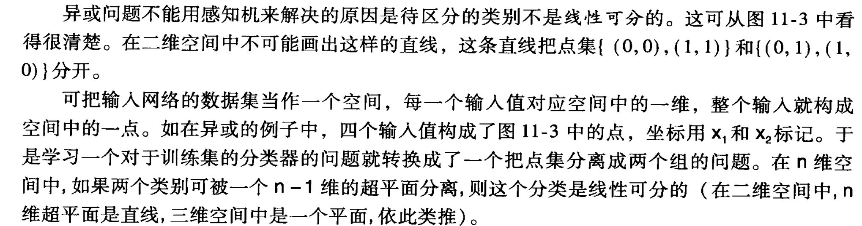
11.2.1The Perceptron Training Algorithm
Consider a perceptron. In order to learn this function, a network must find a weight assignment.

Slide 21
11.2.2 An example: Using a Perceptron Network to Classify
Raw data from a space of possible points are selected and transduced to a new data/pattern space
In this new pattern space features are identified
The entity these features represent is classified
从可能的问题空间中选择原始数据，然后变换成新的数据/模式空间
在这新的模式空间中，空间特征被确定
对这些特征所表示的实体分类

Slide 22
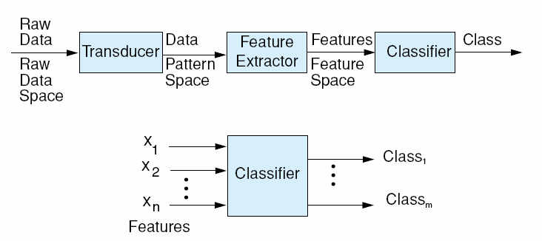
11.2.2 An example: Using a Perceptron Network to Classify
Fig 11.4 A full classification system.

Slide 23
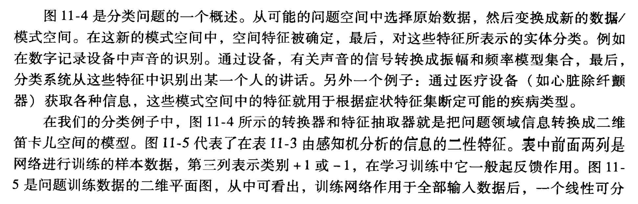
11.2.2 An example: Using a Perceptron Network to Classify
Another example is the capture of information by medical test equipment. The features found in this pattern space would then be used to classify symptom sets into different disease categories.

Slide 24
11.2.2 An example: Using a Perceptron Network to Classify
In our classification example, the transducer and feature extrator of Figure 11.4 translates the problem information into parameters of a two-dimensional Cartesian space. Figure 11.5 presents the two-feature perceptron analysis of the information in Table 11.3

Slide 25
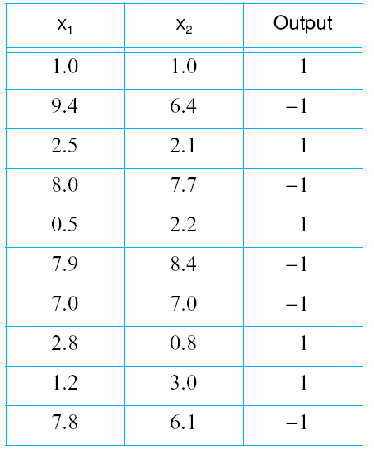
11.2.2 An example: Using a Perceptron Network to Classify
Table 11.3 A data set for perceptron classification.

Slide 26
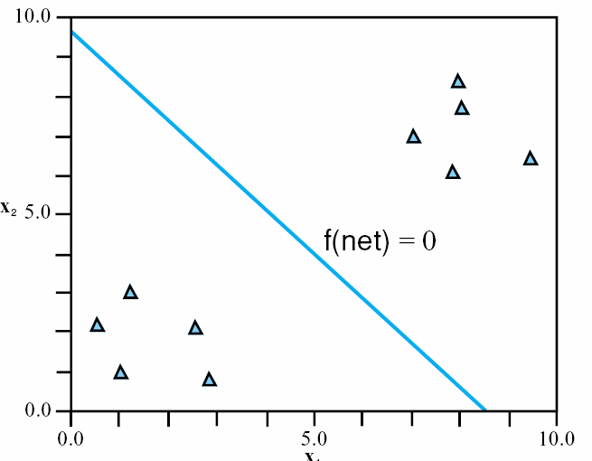
11.2.2 An example: Using a Perceptron Network to Classify
Fig 11.5 A two-dimensional plot of the data points in Table 11.3. The perceptron of Section 11.2.1 provides a linear separation of the data sets.

Slide 27
11.2.2 An example: Using a Perceptron Network to Classify
An important special case of discriminant functions is one with evaluates class membership based on the distance from some central point in the region.
Classification based on this discriminant function is called minimum distance classification.
The perceptron of Figure 11.6 will compute this linear function. We need two input parameters and will have a bias with a constant value of 1. The perceptron computes:

Slide 28
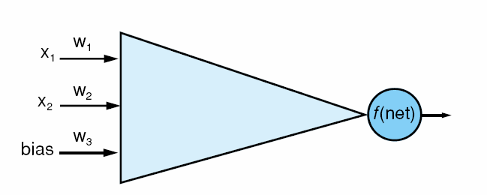
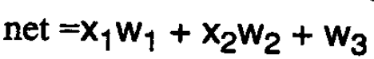
11.2.2 An example: Using a Perceptron Network to Classify
Fig 11.6 The perceptron net for the example data of Table 11.3. The thresholding function is linear and bipolar (see fig 11.7a)

Slide 29
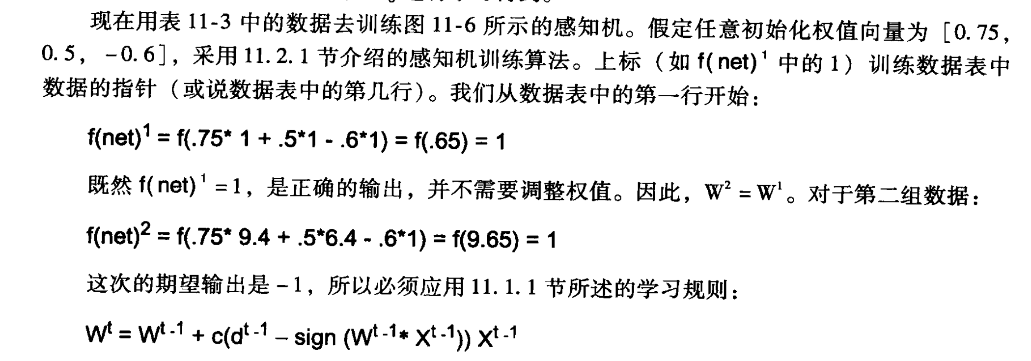
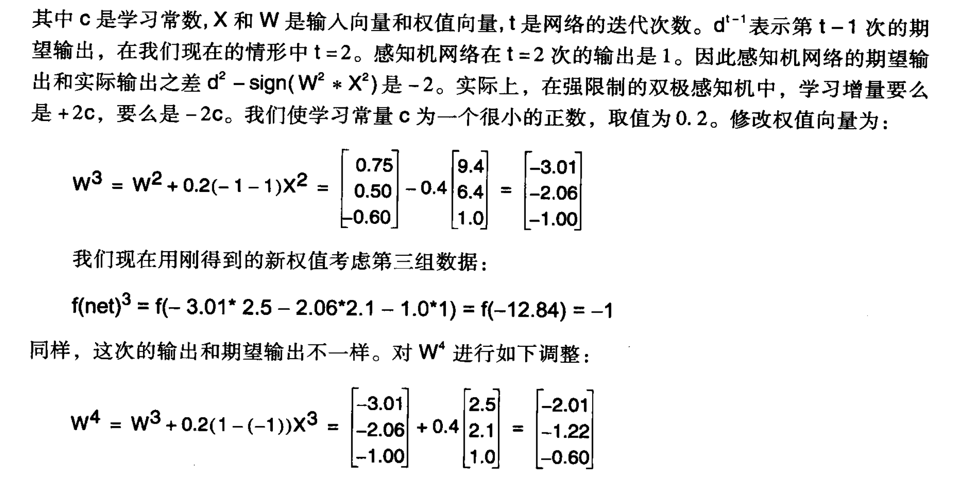
11.2.2 An example: Using a Perceptron Network to Classify

Slide 30
11.2.3 The Generalized Delta Rule
A straightforward way to generalize the perceptron network is to replace its hard limiting thresholding function with other types of activation functions.
扩展感知机网络最好的方法是用其他激励函数代替强限制的阈值函数。连续的激励函数能够提供更好的误差测量粒度，提供更精确的学习方法。

Slide 31
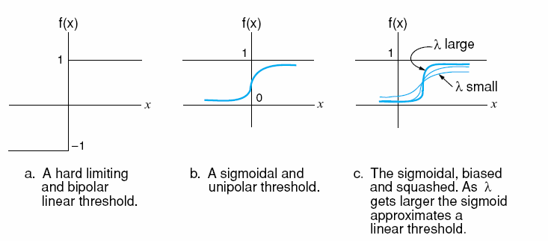
11.2.3 The Generalized Delta Rule
Fig 11.7 Thresholding functions.

Slide 32
11.2.3 The Generalized Delta Rule
A common sigmoidal activation function, called the logistic function, is given by the equation:
The historical emergence of networks with continuous activation functions suggested new approaches to error reduction learning.
The most important learning rule for continuous activation functions is the delta rule.

Slide 33
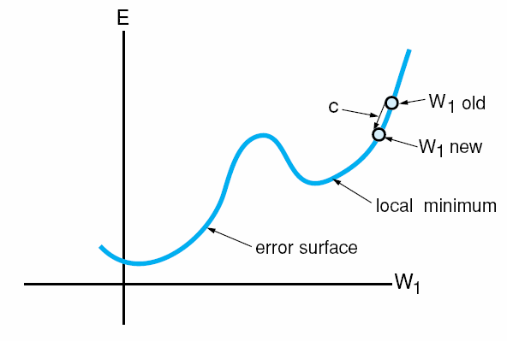
11.2.3 The Generalized Delta Rule
Fig 11.8 An error surface in two dimensions. Constant c dictates the size of the learning step.

Slide 34
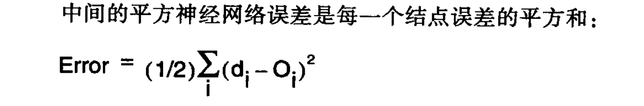
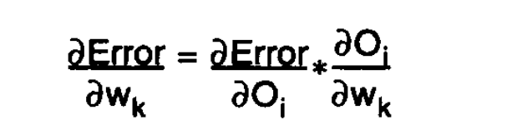
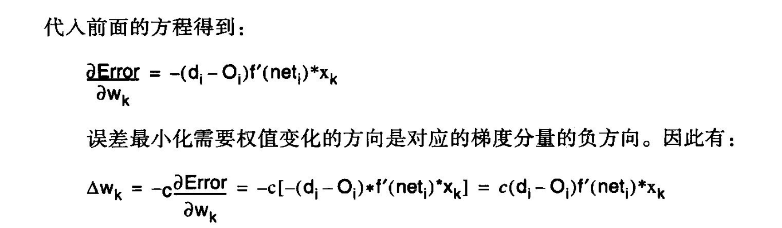
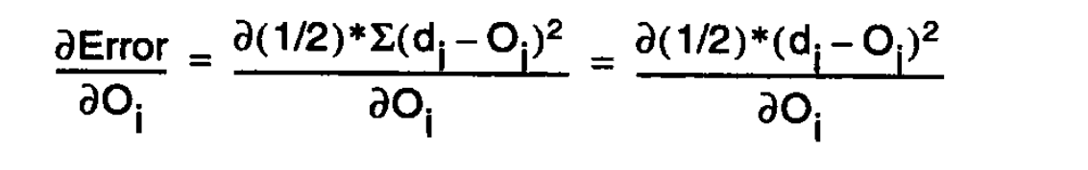
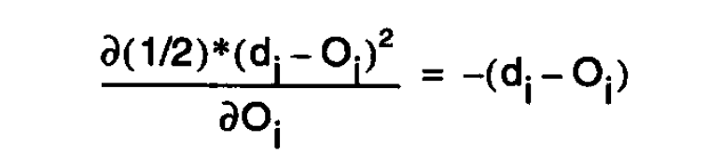
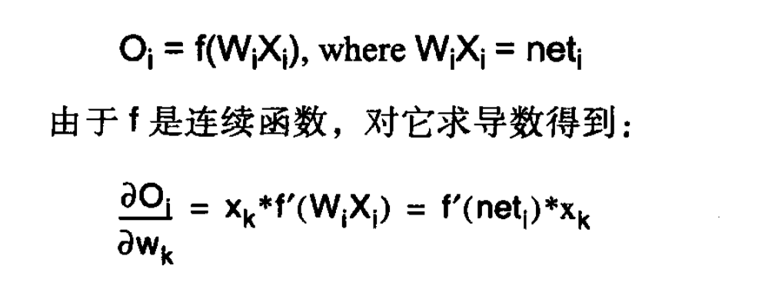
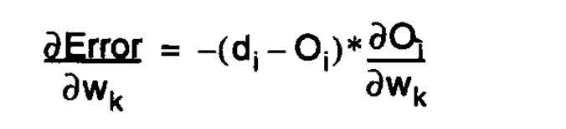
11.2.3 The Generalized Delta Rule

Slide 35
11.2.3 The Generalized Delta Rule
The delta rule is based on the idea of an error surface.
The error surface represents cumulative error over a data set as a function of network weights.
Each possible network weight configuration is represents by a point on this n-dimensional error surface.
Given a weight configuration, we want our learning algorithm to find the direction on this surface which most rapidly reduces the error. This approach is called gradient descent learning because the gradient is a measure of slope, as a function of direction, from a point on a surface.
To use the delta rule, the network must use an activation function which is continuous and therefore differentiable.

Slide 36
11.2.3 The Generalized Delta Rule
The delta rule is like hill-climbing
The learning constant, c, exerts an important influence on the performance of the delta rule.
If c is too large, the algorithm may overshoot the minimum or oscillate around the optimal weights.
Smaller values of c are less prone to this problem, but do not allow the system to learn as quickly.
Although the delta rule does not by itself overcome the limitations of single layer networks, its generalized form is central to the functioning of the backpropagation algorithm, an algorithm for learning in a multilayer network.

Slide 37
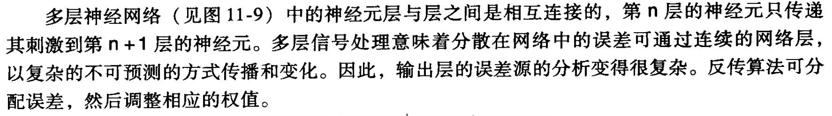
11.3 Backpropagation Learning
The neurons in a multilayer network are connected in layers, with units in layer n passing their activations only to neurons in layer n+1.
Multilayer signal processing means that errors deep in the network can spread and evolve in complex, unanticipated ways through successive layers.
The analysis of the source of error at the output layer is complex.
Backpropagation provides an algorithm for apportioning blame and adjusting weights accordingly.

Slide 38
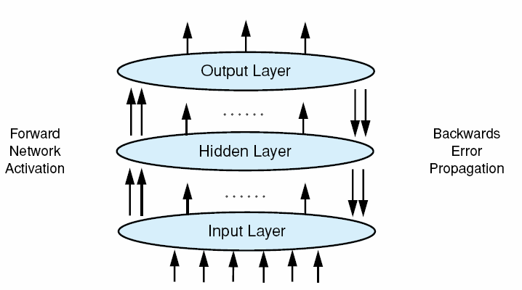
11.3.1 Deriving the Backpropagation Algorithm
Fig 11.9 Backpropagation in a connectionist network having a hidden layer.

Slide 39
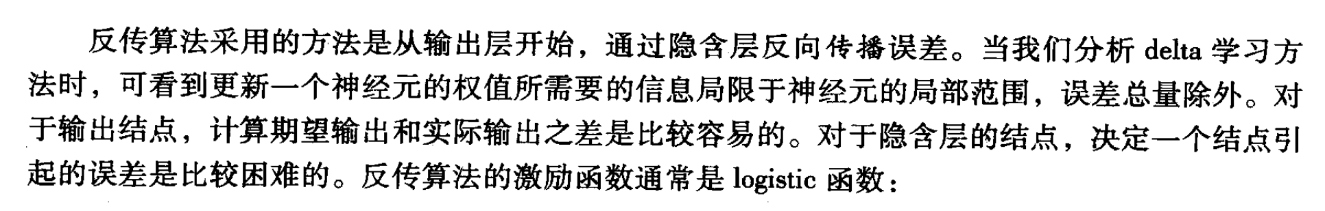
11.3.1 Deriving the Backpropagation Algorithm
The approach taken by the backpropagation algorithm is to start at the output layer and propagate error backwards through the hidden layers.
When we analyzed learning with the delta rule, we saw that all the information needed to update the weights on a neuron was local to that neuron, except for the amount of error.
For output nodes, this is easily computed as the difference between the desired and actual output values. For nodes in the hidden layers, it is considerably more difficult to determine the error for which a node is responsible.

Slide 40
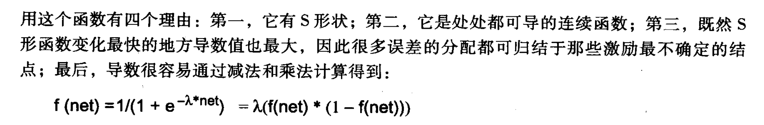
11.3.1 Deriving the Backpropagation Algorithm
The activation function for backpropagation is usually the logistic function:
This function is used for four reasons:
It has the sigmoid shape
As a continuous function, it has a derivative everywhere.
Since the value of the derivative is greatest where the sigmoidal function is changing most rapidly, the assignment of the most error is attributed to those nodes whose activation was least certain.
The derivative is easily computed by a subtraction and multiplication:

Slide 41
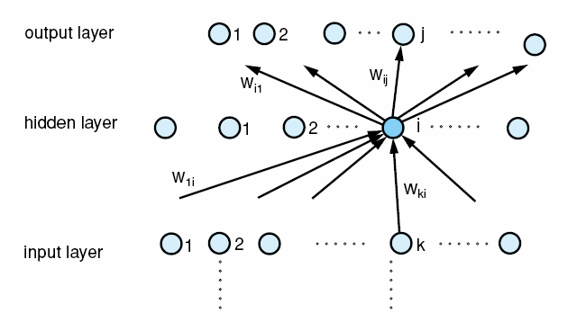
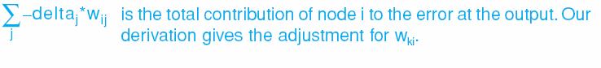
11.3.1 Deriving the Backpropagation Algorithm

Slide 42
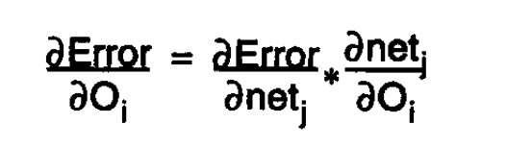
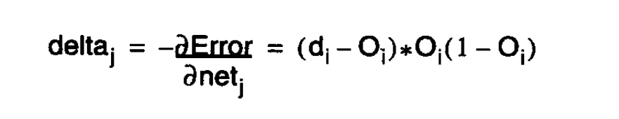
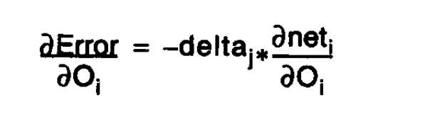
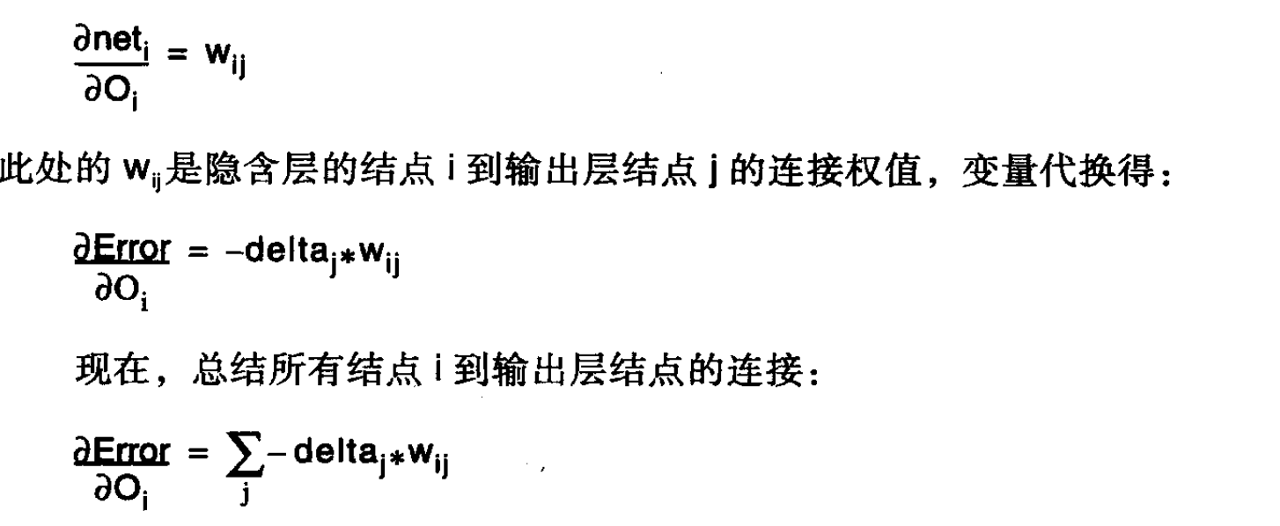
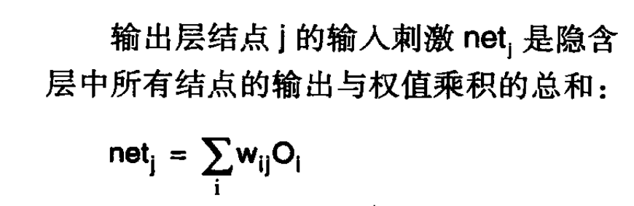
11.3.1 Deriving the Backpropagation Algorithm

Slide 43
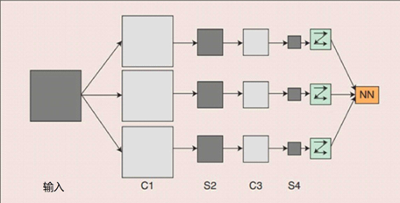
11.4 Convolutional Nerual Network
概念示范：输入图像通过与m个可训练的滤波器和可加偏置进行卷积，在C1层产生m个特征映射图，然后特征映射图中每组的n个像素再求和，加权值，加偏置，通过Sigmoid函数得到m个S2层的特征映射图。这些映射图再进过滤波得到C3层。这个层级结构再和S2一样产生S4。最终，这些像素值被光栅化，并连接成一个向量输入到传统神经网络，得到输出。
CNN是一个多层的神经网络，每层由多个二维平面组成，而每个平面由多个独立神经元组成。
C层为特征提取层（卷积层）
S层是特征映射层（下采样层）。
CNN中的每一个C层都紧跟着一个S层。

Slide 44
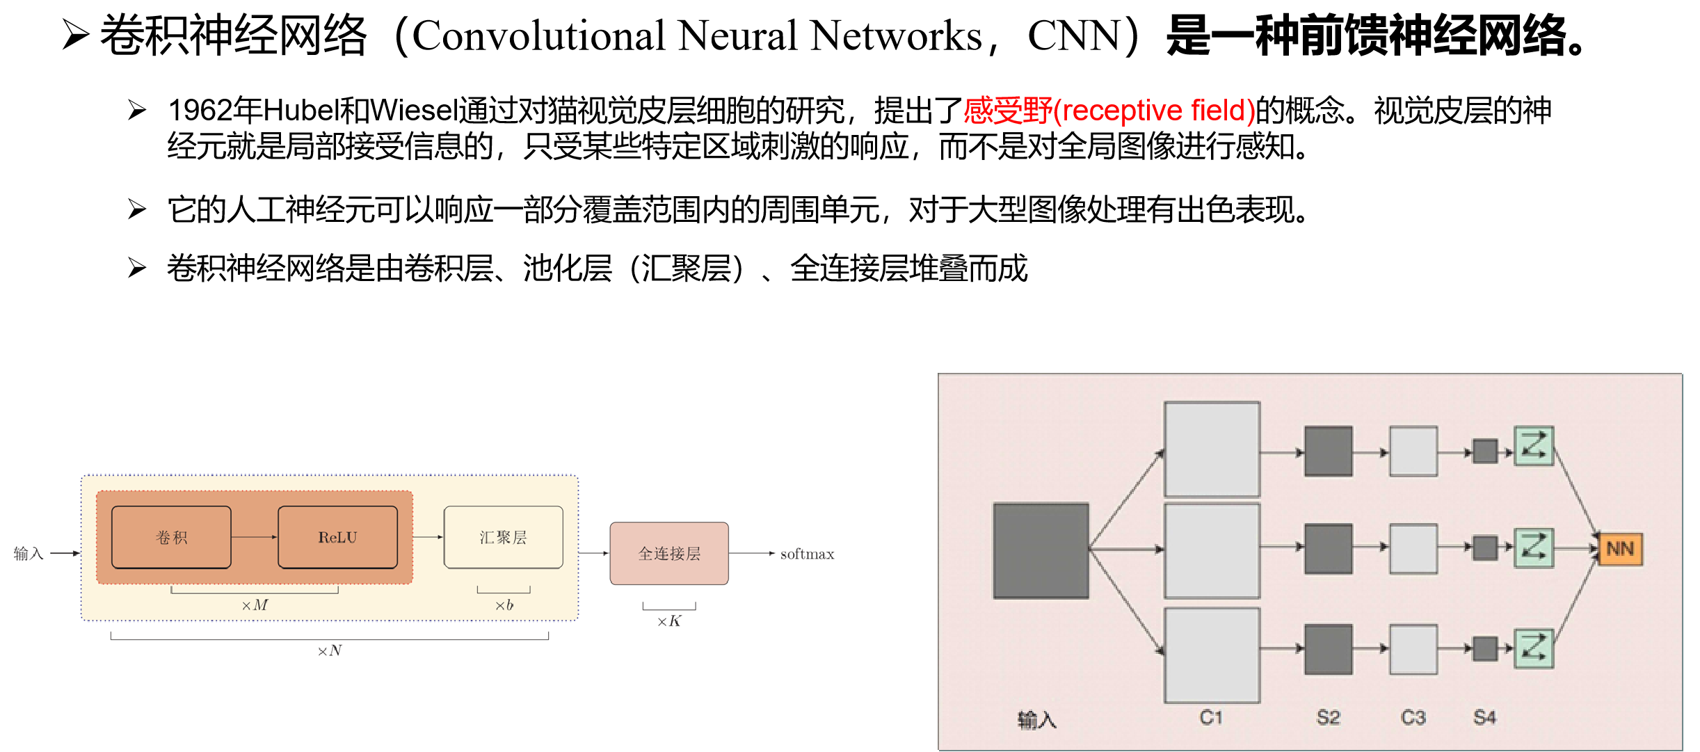
11.4 Convolutional Nerual Network

Slide 45
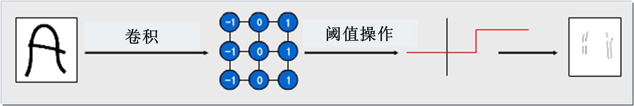
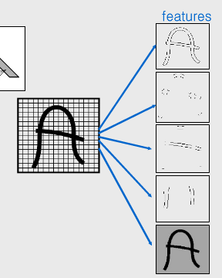
11.4 Convolutional Nerual Network
特征提取层（卷积层）——C层（Convolution layer）
大部分的特征提取都依赖于卷积运算
利用卷积算子对图像进行滤波，可以得到显著的边缘特征。

Slide 46
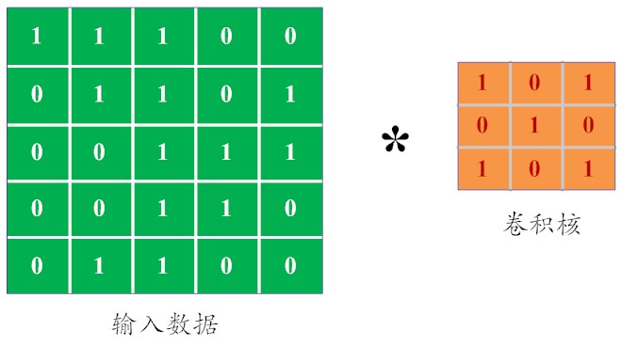
11.4 Convolutional Nerual Network

Slide 47
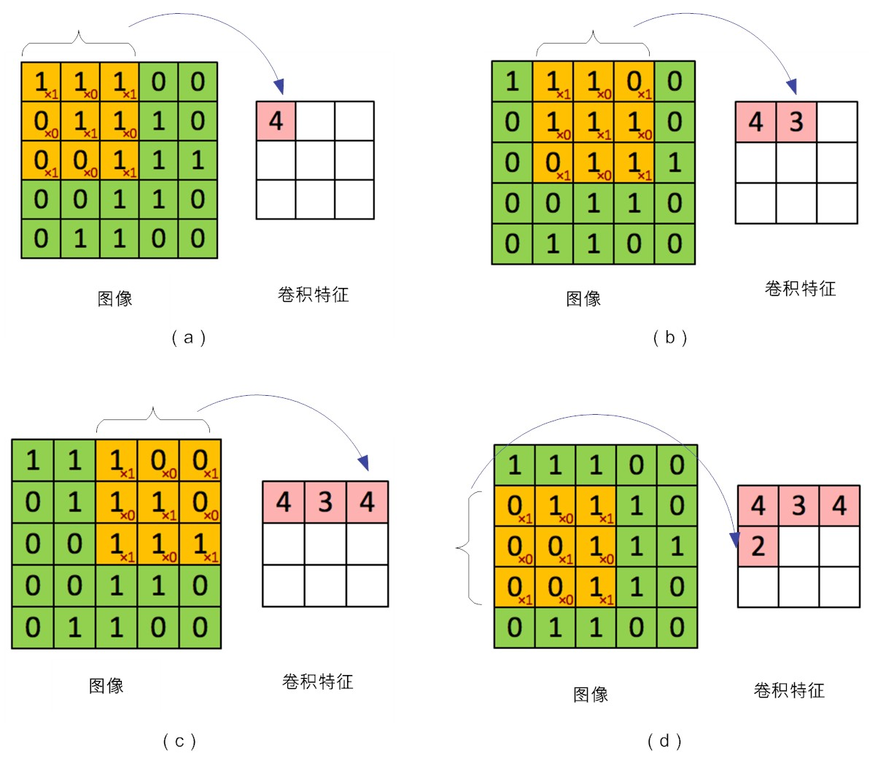
11.4 Convolutional Nerual Network

Slide 48

11.4 Convolutional Nerual Network
填充

Slide 49

11.4 Convolutional Nerual Network

Slide 50

11.4 Convolutional Nerual Network

Slide 51






11.4 Convolutional Nerual Network
8=0+4+3+1
*
*
*
=0
=4
=8
=3
=1

Slide 52

11.4 Convolutional Nerual Network
池化

Slide 53

11.4 Convolutional Nerual Network

Slide 54

11.4 Convolutional Nerual Network
难以训练

Slide 55

11.4 Convolutional Nerual Network

Slide 56

11.4 Convolutional Nerual Network

Slide 57

11.4 Convolutional Nerual Network

Slide 58

11.5 Generative Adversarial Networks

Slide 59

11.5Generative Adversarial Networks

Slide 60

11.5Generative Adversarial Networks

Slide 61

11.5Generative Adversarial Networks

Slide 62

11.5Generative Adversarial Networks

Slide 63

11.5Generative Adversarial Networks

Slide 64

11.5Generative Adversarial Networks

